Slide 1
x
F
l

Slide 2
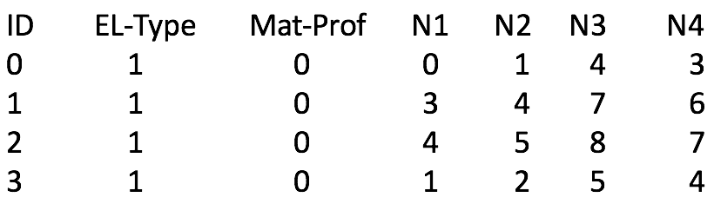
ID X Y BC_{x} BC_{y}
0 0.0 0.0 0 -1
1.5 0.0 -1 -1
2.0 0.0 0 -1
0.0 0.8 0 0
1.2 1.0 0 0
2.0 1.2 0 0
0.0 2.0 0 0
0.8 2.0 0 0
2.0 2.0 0 0
ID EL-Type Mat-Prof N1 N2 N3 N4
0 1 0 0 1 4 3
1 1 0 3 4 7 6
2 1 0 4 5 8 7
3 1 0 1 2 5 4

Slide 3
U^{C}
u₀
u₁
u^{Q}
U_{k-1}
Element Q
U_{k}
U_{k+1}
U_{N}

Slide 4
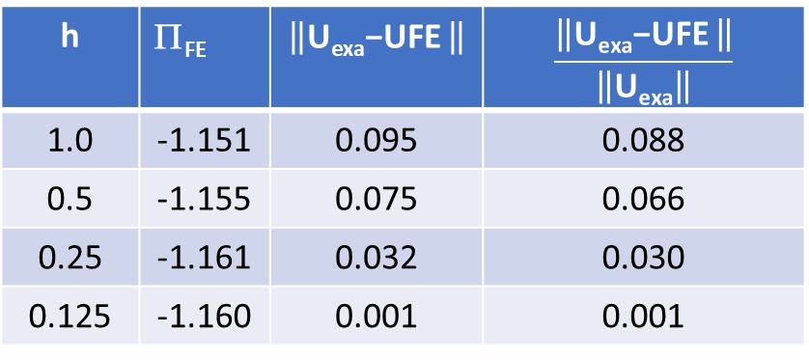
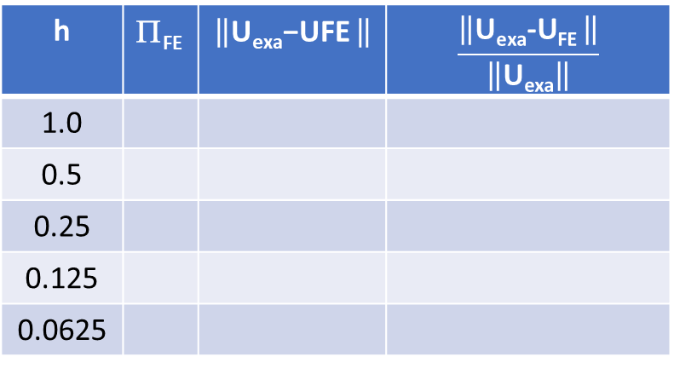
h | Π_{FE} | $$\left\|\text{U}\text{exa}\text{−}\text{UFE} \right\|$$ | $$\frac{\left\|\text{U}\text{exa}\text{−}\text{UFE} \right\|}{\left\|\text{U}\text{exa}\right\|}$$
1.0
0.5
0.25
0.125
0.0625
h | Π_{FE} | $$\left\|\text{U}\text{exa}\text{−}\text{UFE} \right\|$$ | $$\frac{\left\|\text{U}\text{exa}\text{−}\text{UFE} \right\|}{\left\|\text{U}\text{exa}\right\|}$$
1.0 | -1.151 | 0.095 | 0.088
0.5 | -1.155 | 0.075 | 0.066
0.25 | -1.161 | 0.032 | 0.030
0.125 | -1.160 | 0.001 | 0.001

Slide 5
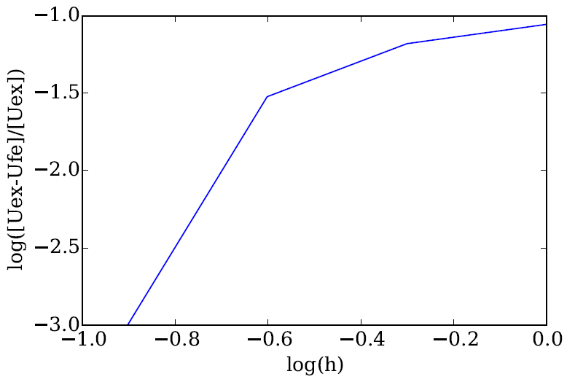

Slide 6
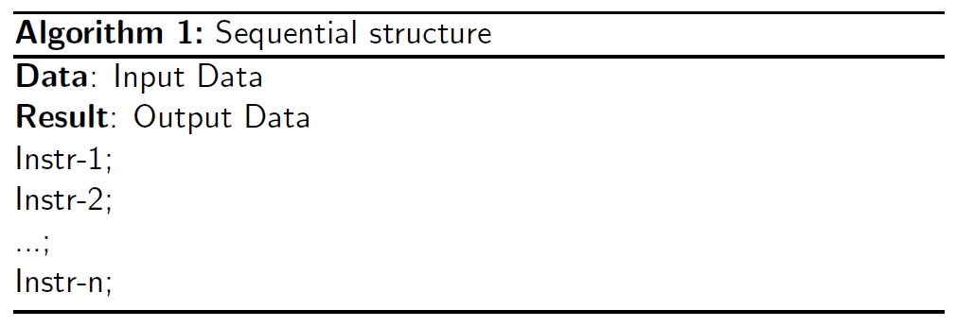
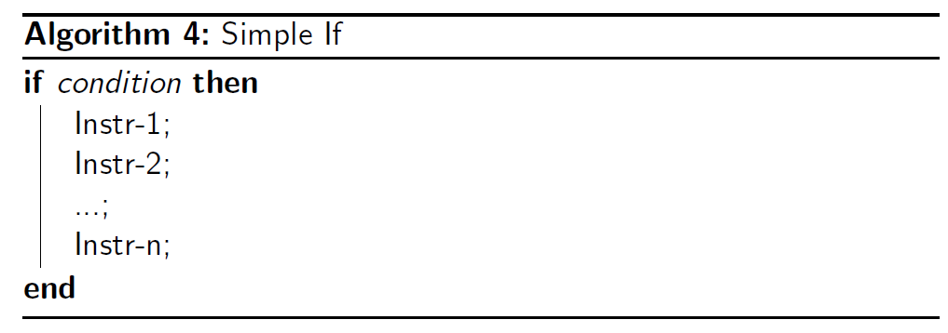

Slide 7
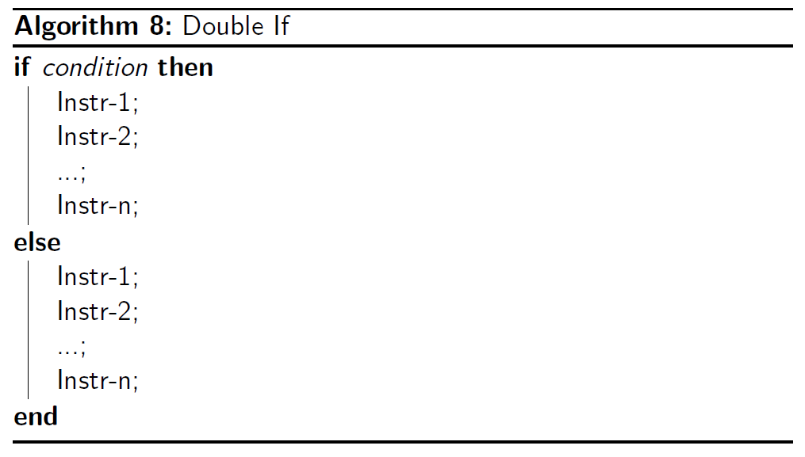

Slide 8
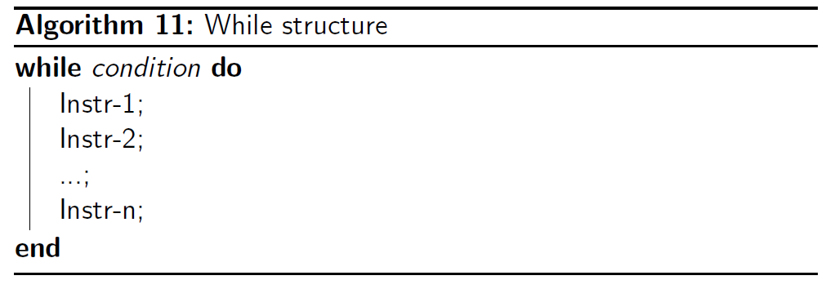

Slide 9
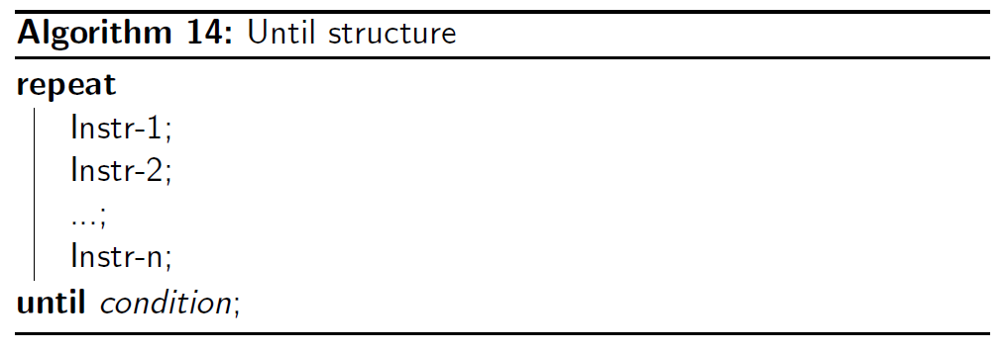

Slide 10
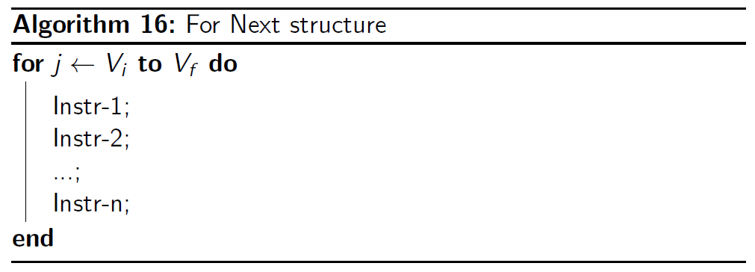

Slide 12
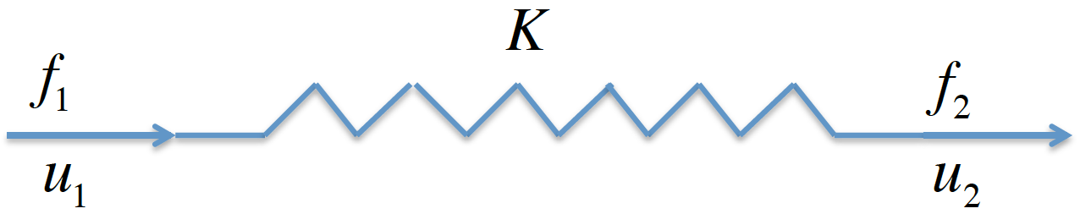

Slide 13
